Slide 1

Reunión TFG del 3 de abril

Slide 2
Modelos que quiero desarrollar:
Transformer (Univariate) with downloaded dataset -> Para aprender
Transformer (Multivariate) with our dataset but univariate
Transformer (Multivariate) with downloaded dataset -> Para aprender
Transformer (Multivariate) with our dataset
Informer (Multivariate) with downloaded dataset -> Para aprender
Informer (Multivariate) with our dataset
Autofomer (Multivariate) with downloaded dataset -> Para aprender
Autoformer (Multivariate) with our dataset

Slide 3
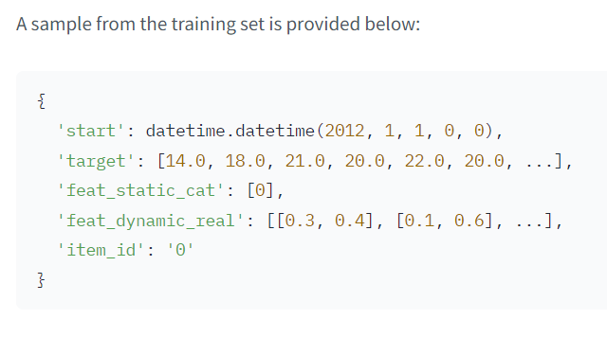
Dataset downloaded (univariate)
https://forecastingdata.org/
https://huggingface.co/datasets/monash_tsf/viewer/tourism_monthly
Data Fields
For the univariate regular time series each series has the following keys:
start: a datetime of the first entry of each time series in the dataset
target: an array[float32] of the actual target values
feat_static_cat: an array[uint64] which contains a categorical identifier of each time series in the dataset
feat_dynamic_real: optional array of covariate features
item_id: a string identifier of each time series in a dataset for reference
For the multivariate time series the target is a vector of the multivariate dimension for each time point.
Univariate: A dataset contains monthly tourism volumes for 366 regions in Australia.
Multivariate: A dataset contains the San Francisco Traffic dataset used by Lai et al. (2017). It contains 862 hourly time series showing the road occupancy rates in the range [0,1][0,1] on the San Francisco Bay area freeways from 2015 to 2016.

Slide 4
Code Structure Transformer Univariate
# prediction length:
prediction_length=prediction_length,
# context length:
context_length=prediction_length * 2,
# lags coming from helper given the freq:
lags_sequence=lags_sequence,
# we'll add 2 time features ("month of year" and "age", see further):
num_time_features=len(time_features) + 1,
# we have a single static categorical feature, namely time series ID:
num_static_categorical_features=1,
# it has 366 possible values:
cardinality=[len(train_dataset)],
# the model will learn an embedding of size 2 for each of the 366 possible values:
embedding_dimension=[2],
# transformer params:
encoder_layers=4,
decoder_layers=4,
d_model=32,
main
load_and_preprocess_dataset
Load dataset
Split the data in train and test
Convert to pd.Period
define_my_model
1 - Lags_sequence
2 - Time_features
3 – Define config
Create Data Loaders
DataLoaders, allow us to have batches of (input, output) pairs - or in other words (past_values, future_values).
create_train_dataloader
1 - Definition of input names for prediction and training: Lists of field names are defined for prediction and training inputs.
2 - create_transformation
Remove static/dynamic fields if not specified: Fields are removed if the number of specified static or dynamic features is zero.
Convert the data to NumPy: Data is converted to NumPy arrays for static categorical and real features if they exist.
Handle NaN values: Indicators for observed values are added to handle NaN values in the target field.
Add temporal features: Features like month of the year are added based on the data frequency.
Add an age feature: A feature indicating the "age" of the time series is added, representing how long it has been since the series started.
Vertically stack temporal features: All temporal features are stacked vertically into a single field.
Rename fields: Fields are renamed to match HuggingFace library conventions.
3 - Data caching (optional): Transformed data is cached if specified.
4 - create_instance_splitter
Is used to sample windows from the dataset for training/validation/testing
5 - Training instance sampling: The instance splitter randomly samples training instances from transformed time series data.
6 - Batch creation: Batches of training data are created according to the model's input dimensions and batch size, potentially shuffling the batches.
create_backtest_dataloader
Train_model
Accelerator initialization
Model transfer to device: The model is moved to the appropriate device (GPU or CPU) using the to() method of the Accelerator.
Optimizer initialization: An AdamW optimizer is initialized with model parameters and specified hyperparameters.
Model and optimizer preparation: The model and optimizer are prepared for training using the prepare() method of the Accelerator.
Training mode activation: The model's training mode is activated using the train() method.
Training loop: The training loop iterates over the specified number of epochs:
Model output computation: Model outputs are computed for the current batch using the forward() method.
Loss calculation: The loss is calculated based on the model outputs.
Backpropagation and parameter update: Backpropagation is performed to compute gradients, and model parameters are updated using the optimizer.
Evaluate Model
forecasting
see_metrics
plot

Slide 5
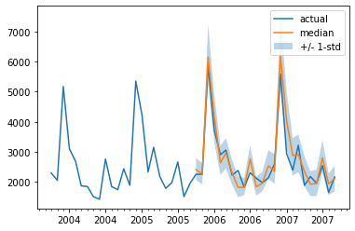
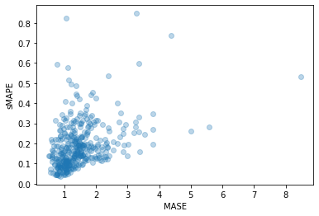
Transformer Univariate Result (Loading example)

Slide 6
Code Structure Transformer Multivariate
# in the multivariate setting, input_size is the number of variates in the time series per time step:
input_size=num_of_variates,
# prediction length:
prediction_length=prediction_length,
# context length:
context_length=prediction_length * 2,
# lags value copied from 1 week before:
lags_sequence=[1, 24 * 7],
# we'll add 2 time features ("month of year" and "age", see further):
num_time_features=len(time_features) + 1,
# transformer params:
dropout=0.1,
encoder_layers=6,
decoder_layers=4,
d_model=64,
main
load_and_preprocess_dataset
Load dataset
Split the data in train and test
Convert to pd.Period
MultivariateGrouper
define_my_model
1 - Lags_sequence
2 - Time_features
3 – Define config
Create Data Loaders
DataLoaders, allow us to have batches of (input, output) pairs - or in other words (past_values, future_values).
create_train_dataloader
1 - Definition of input names for prediction and training: Lists of field names are defined for prediction and training inputs.
2 - create_transformation
Remove static/dynamic fields if not specified: Fields are removed if the number of specified static or dynamic features is zero.
Convert the data to NumPy: Data is converted to NumPy arrays for static categorical and real features if they exist.
Handle NaN values: Indicators for observed values are added to handle NaN values in the target field.
Add temporal features: Features like month of the year are added based on the data frequency.
Add an age feature: A feature indicating the "age" of the time series is added, representing how long it has been since the series started.
Vertically stack temporal features: All temporal features are stacked vertically into a single field.
Rename fields: Fields are renamed to match HuggingFace library conventions.
3 - Data caching (optional): Transformed data is cached if specified.
4 - create_instance_splitter
Is used to sample windows from the dataset for training/validation/testing
5 - Training instance sampling: The instance splitter randomly samples training instances from transformed time series data.
6 - Batch creation: Batches of training data are created according to the model's input dimensions and batch size, potentially shuffling the batches.
create_backtest_dataloader
Train_model
Accelerator initialization
Model transfer to device: The model is moved to the appropriate device (GPU or CPU) using the to() method of the Accelerator.
Optimizer initialization: An AdamW optimizer is initialized with model parameters and specified hyperparameters.
Model and optimizer preparation: The model and optimizer are prepared for training using the prepare() method of the Accelerator.
Training mode activation: The model's training mode is activated using the train() method.
Training loop: The training loop iterates over the specified number of epochs:
Model output computation: Model outputs are computed for the current batch using the forward() method.
Loss calculation: The loss is calculated based on the model outputs.
Backpropagation and parameter update: Backpropagation is performed to compute gradients, and model parameters are updated using the optimizer.
Evaluate Model
forecasting
see_metrics
plot

Slide 7
Transformer Multivariate Result (Loading example dataset)

Slide 8
Code Structure Informer (Multivariate)
# in the multivariate setting, input_size is the number of variates in the time series per time step:
input_size=num_of_variates,
# prediction length:
prediction_length=prediction_length,
# context length:
context_length=prediction_length * 2,
# lags value copied from 1 week before:
lags_sequence=[1, 24 * 7],
# we'll add 2 time features ("month of year" and "age", see further):
num_time_features=len(time_features) + 1,
# transformer params:
dropout=0.1,
encoder_layers=6,
decoder_layers=4,
d_model=64,
main
load_and_preprocess_dataset
Load dataset
Split the data in train and test
Convert to pd.Period
MultivariateGrouper
define_my_model
1 - Lags_sequence
2 - Time_features
3 – Define config
Create Data Loaders
DataLoaders, allow us to have batches of (input, output) pairs - or in other words (past_values, future_values).
create_train_dataloader
1 - Definition of input names for prediction and training: Lists of field names are defined for prediction and training inputs.
2 - create_transformation
Remove static/dynamic fields if not specified: Fields are removed if the number of specified static or dynamic features is zero.
Convert the data to NumPy: Data is converted to NumPy arrays for static categorical and real features if they exist.
Handle NaN values: Indicators for observed values are added to handle NaN values in the target field.
Add temporal features: Features like month of the year are added based on the data frequency.
Add an age feature: A feature indicating the "age" of the time series is added, representing how long it has been since the series started.
Vertically stack temporal features: All temporal features are stacked vertically into a single field.
Rename fields: Fields are renamed to match HuggingFace library conventions.
3 - Data caching (optional): Transformed data is cached if specified.
4 - create_instance_splitter
Is used to sample windows from the dataset for training/validation/testing
5 - Training instance sampling: The instance splitter randomly samples training instances from transformed time series data.
6 - Batch creation: Batches of training data are created according to the model's input dimensions and batch size, potentially shuffling the batches.
create_backtest_dataloader
Train_model
Accelerator initialization
Model transfer to device: The model is moved to the appropriate device (GPU or CPU) using the to() method of the Accelerator.
Optimizer initialization: An AdamW optimizer is initialized with model parameters and specified hyperparameters.
Model and optimizer preparation: The model and optimizer are prepared for training using the prepare() method of the Accelerator.
Training mode activation: The model's training mode is activated using the train() method.
Training loop: The training loop iterates over the specified number of epochs:
Model output computation: Model outputs are computed for the current batch using the forward() method.
Loss calculation: The loss is calculated based on the model outputs.
Backpropagation and parameter update: Backpropagation is performed to compute gradients, and model parameters are updated using the optimizer.
Evaluate Model
forecasting
see_metrics
plot

Slide 9
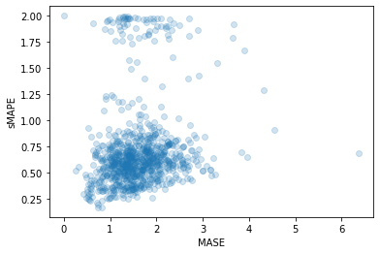
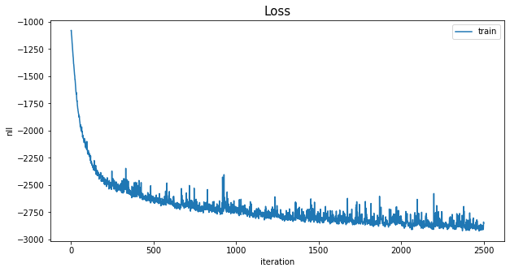
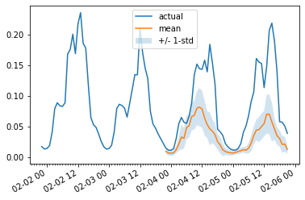
Transformer Multivariate Result (Loading example dataset)

Slide 10
the multivariate forecasts are typically worse than the univariate ones, the reason being the difficulty in estimating the cross-series correlations/relationships. The additional variance added by the estimates often harms the resulting forecasts or the model learns spurious correlations. We refer to this paper for further reading. Multivariate models tend to work well when trained on a lot of data.

